Slide 1
Chapter 1
International Financial Reporting Standards
Notes:
Tutor guidance
Introduce the session quickly
Ensure students are aware that the topics to be covered in the session are covered in Chapter 1 of their study material
Narrative
In this chapter we’ll explore international financial reporting standards and how they interact with local, country-specific accounting guidance. We’ll also see how IFRS Standards are developed.

Slide 2
Key to chapter content ICONS
Notes:
Tutor guidance
You may wish to skip this slide – it provides a reference showing the type of content included in different slide types throughout the chapter

Slide 3
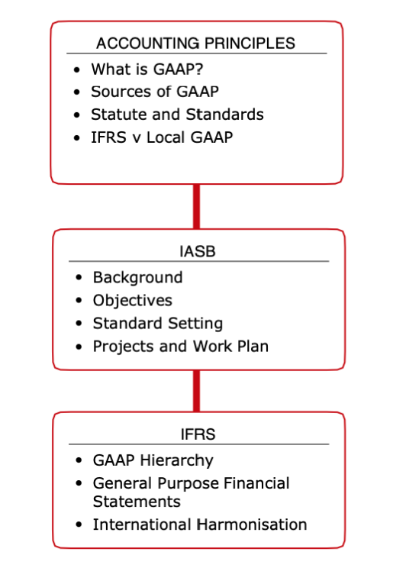
CHAPTER 1: International Financial Reporting Standards
Notes:
Tutor guidance
Run over what’s in the chapter and what we cover in this session
Narrative
In Chapter 1 we’ll be introducing international financial reporting standards. We start by looking at how these standard fit into the wider accounting framework, known as GAAP or Generally Accepted Accounting Practices. Then we’ll move on and think about the body that sets international financial reporting standards, and how it goes about setting them. Finally, we’ll consider which types of entity use IFRS and how internationally accepted they actually are.

Slide 4
What is GAAP?
GAAP: Generally Accepted Accounting Principles
Sources
Laws
Industry groups
Listing rules
Best practice
Accounting standards
Notes:
Tutor guidance
Students are likely to have heard the term ‘GAAP’ but may not know what it means or what it includes. Run through the sources of GAAP on the slide, pointing out that in their FR exam we concentrate only on accounting standards.
Narrative
GAAP stands for generally accepted accounting principles or, in some cases, generally accepted accounting practice. It is a general term for a set of reporting guidelines and is usually country specific, so you may hear reference to ‘US GAAP’ or ‘Zambian GAAP’ for example. Sometimes you’ll also hear reference to ‘international GAAP’.
There are various sources of guidance, rules and regulations within any given GAAP. To start with there is law and statute – most countries will have companies legislation of some form, for example Nigeria has the Companies and Allied Matters Act of 2020 and Kenya has the Companies Act of 2015.
Companies listed on a stock exchange such as that in Johannesburg or Dar Es Salaam are also likely to have to follow listing rules laid down specifically by the relevant exchange.
We know that there are also accounting standards – which may be international or country specific. And then finally there is following best practice and adopting guidelines provided by industry groups such as the UK based Oil Industry Accounting Committee.
In FR we concentrate only on accounting standards, so let’s move on to think about those in more detail.

Slide 5
Activity: Local GAAP
What are the main sources of local GAAP in your country?
Notes:
Tutor Guidance
Ask students to brainstorm the sources of guidance in their local GAAP.
No answer slide is provided to this activity as it is jurisdiction-specific.

Slide 6
The International Accounting Standards Board
IFRS Foundation
delegates standard setting to
International Accounting Standards Board
Mission: to develop IFRS Standards that bring transparency, accountability and efficiency to financial markets around the world
Notes:
Tutor guidance
A quick introduction to the IFRS Foundation and IASB is all that is required here.
Narrative
International accounting standards are set by the International Accounting Standards Board or IASB.
This body, which is made up of members from all over the world sits within the wider IFRS Foundation, which is a not-for-profit, public interest organisation.
The mission of the IASB and the IFRS Foundation is to develop IFRS Standards that bring transparency, accountability and efficiency to financial markets globally.
Although the IASB is responsible for amending existing and issuing new IAS and IFRS Standards, other bodies are also involved in the process, including national standard setters and national accountancy bodies.
Let’s move on to think about the development of IFRS Standards and how those bodies are involved.

Slide 7
Standard Setting – Due Process
Topic added to agenda
Exposure draft
IFRS issued
Discussion paper
Maintain
IASB Workplan
Major projects only
Mandatory for all new/amended standards
Requires supermajority approval
Post-implementation review programme
National bodies provide feedback
Need for amendments identified
Notes:
Tutor guidance
Run through the process to develop standards, referring to recent examples that you know of.
Narrative
The process to develop or amend an IFRS Standard is known as ‘due process’:
Firstly a topic is added to the agenda, in other words it is accepted that guidance on a particular topic should be developed, possibly as a result of calls from users or preparers of financial statements. The IASB runs a workplan, which through which all of its current projects are run.
In the process of developing a new standard or an amendment, the first stage is a discussion paper. This is a non-mandatory step and tends to be issued for major projects only. Discussion papers usually include an overview of the issue and possible approaches to addressing it and they are designed to elicit comments from interested parties, such as national accounting bodies, so that the IASB can decide whether to and how to proceed.
The next stage in the process is an exposure draft or ED, which is a mandatory step. An ED contains the proposed contents of a new standard or the proposed amendments to an existing standard. Comments are invited from interested parties such as national standard setters and national accountancy bodies and these help to shape the final IFRS Standard. The most significant recent ED was issued in December 2019 and proposes changes to IAS 1, which we cover in Chapter 3.
The issue of a final standard or amendments is the next stage in the process and this requires what’s referred to as a supermajority of IASB members to support it - around a 60% majority. So there is no need for all Board members to agree to an IFRS or amendment and indeed in most cases they don’t!
Finally after the issue of a standard there is a maintenance programme to ensure that the standard is working as it should. In the case of a major new IFRS Standards this is achieved through a post-implementation review that is carried out when a standard has been applied for a few years. It considers issues such as whether the standard’s objectives have been achieved and whether implementation problems have been encountered. Where further changes are required these the process starts again!

Slide 8
IFRS Harmonisation and Convergence
IFRS Standards may be used:
As national requirements e.g. UK, EU, Canada, Ghana, S Africa
As a basis for national requirements e.g. Hong Kong, Singapore, Malaysia, Australia, New Zealand
As a benchmark for development of national standards e.g. India, Vietnam
By large companies through choice e.g. US companies
US has not adopted IFRS
Notes:
Tutor guidance
Explain the use of IFRS standards around the world using the examples on the slide and any others that you know of.
Narrative
We’ve now met the bodies of the IFRS Foundation and seen how the IASB sets standards, but what about use of IFRS throughout the world?
The ideal for the IFRS Foundation is probably that all companies around the world use IFRS Standards, but realistically this will never happen, for a variety of reasons. It is, however true, that more and more countries are adopting IFRS in one way or another – although often only for listed companies. It may be that they
Adopt IFRS directly as is the case for listed companies in the UK and EU, South Africa, Ghana and Nigeria or
They adopt IFRS almost word for word but rebrand them as national standards – this has happened for example in Hong Kong where HKFRS are applied
They use IFRS as a benchmark for developing national standards such that over time we move closer to convergence (where local GAAP is gradually replaced by IFRS) – for example in India and Vietnam
Or it may be that large companies choose to prepare a second set of financial statements in IFRS in order to access international capital. This is true of many US companies – the US has not adopted and does not intend to adopt IFRS and domestic companies may not prepare their financial statements for official purposes using IFRS, but many still choose to prepare a second set of IFRS financial statements either because they have a dual listing or for other regulatory or commercial reasons.

Slide 9
Exam focus
A
Background information
OTQ questions?
B
C
unlikely
Notes:
Tutor guidance
This topic is not a very examinable area. It may feature as an OTQ in section A or B, possibly regarding due process, but is unlikely to feature in more than one question. The nature of Section C questions mean that this topic is very unlikely to form any part of a question.
Although not very examinable, students should regard this chapter as essential background information.

Slide 10
Chapter 1: Summary
GAAP or generally accepted accounting principles refers to the various sources of accounting guidance within a particular jurisdiction.
IFRS Standards are set by the International Accounting Standards Board, a body of the IFRS Foundation.
The IASB follows a due process when setting standards. This may include the issue of a discussion paper and must include the issue of an exposure draft.
National standard setters and accountancy bodies may provide feedback to discussion papers and exposure drafts.
IFRS are used in a number of ways including adoption as national standards and rebranding as national standards.
In some countries national standards are gradually converging with IFRS standards.
Notes:
Tutor guidance
A brief recap of what we have covered in this chapter.
Talk through the points on the slide, supplemented by your own thoughts.

Slide 11
Chapter 1: Practice questions
Study Question Bank
IFRS Due Process | 25 mins
* plus time for tutor guidance
For FR
Attempt the Study Question Bank questions listed above after studying this chapter
Attempt Revision Question Bank questions in your revision phase, after studying all chapters
Notes:
Tutor guidance
Questions from the Study Question Bank should ideally be set to do in class.
The stated time allocation is based on 1.8 minutes per mark, which reflects timings in the real exam. As you are setting these questions during the teaching phase of the course, students may need more time to complete them.
We recommend leaving questions from the Revision Question Bank until the revision phase.
In addition to the questions in the Study Question Bank and the Revision Question Bank, there are Additional Questions and Mock Exams available via the Education Hub. Outside of this project, published exams are available on accaglobal and Computer Based Exams are available in the Practice Platform.
When debriefing questions
Pull out the main points from the suggested solution
In a question with a written element, identify any other points that would have earned marks
Emphasise that a perfect answer is not required to score well
Point out where the ‘easiest’ marks were to be gained
Draw on common feedback points from examiner reports
Draw attention to exam technique points that could improve marks, for example showing clear workings in calculation questions and writing concisely and clearly, referencing facts from the scenario in written elements of questions and analysis questions.

Slide 12
Thank you

